Slide 1
eagle–i use cases
Melissa Haendel, Ph.D.
Carlo Torniai, Ph.D
March 2010, OBI workshop
www.eagle-i.org/home

Slide 2
Use cases
Representation of organizations providing a service, and service subtypes
The relationship between protocols, techniques and planned processes
Organizations and roles
Potential classification of instruments based on function or participation in planned processes

Slide 3
Scenario: lab provides a sequencing service
A resource navigator goes to lab in Puerto Rico:
This lab provides a DNA sequencing service
using the ABI 3100 Genetic Analyzer
performing a long read Cycle Sequencing protocol

Slide 4
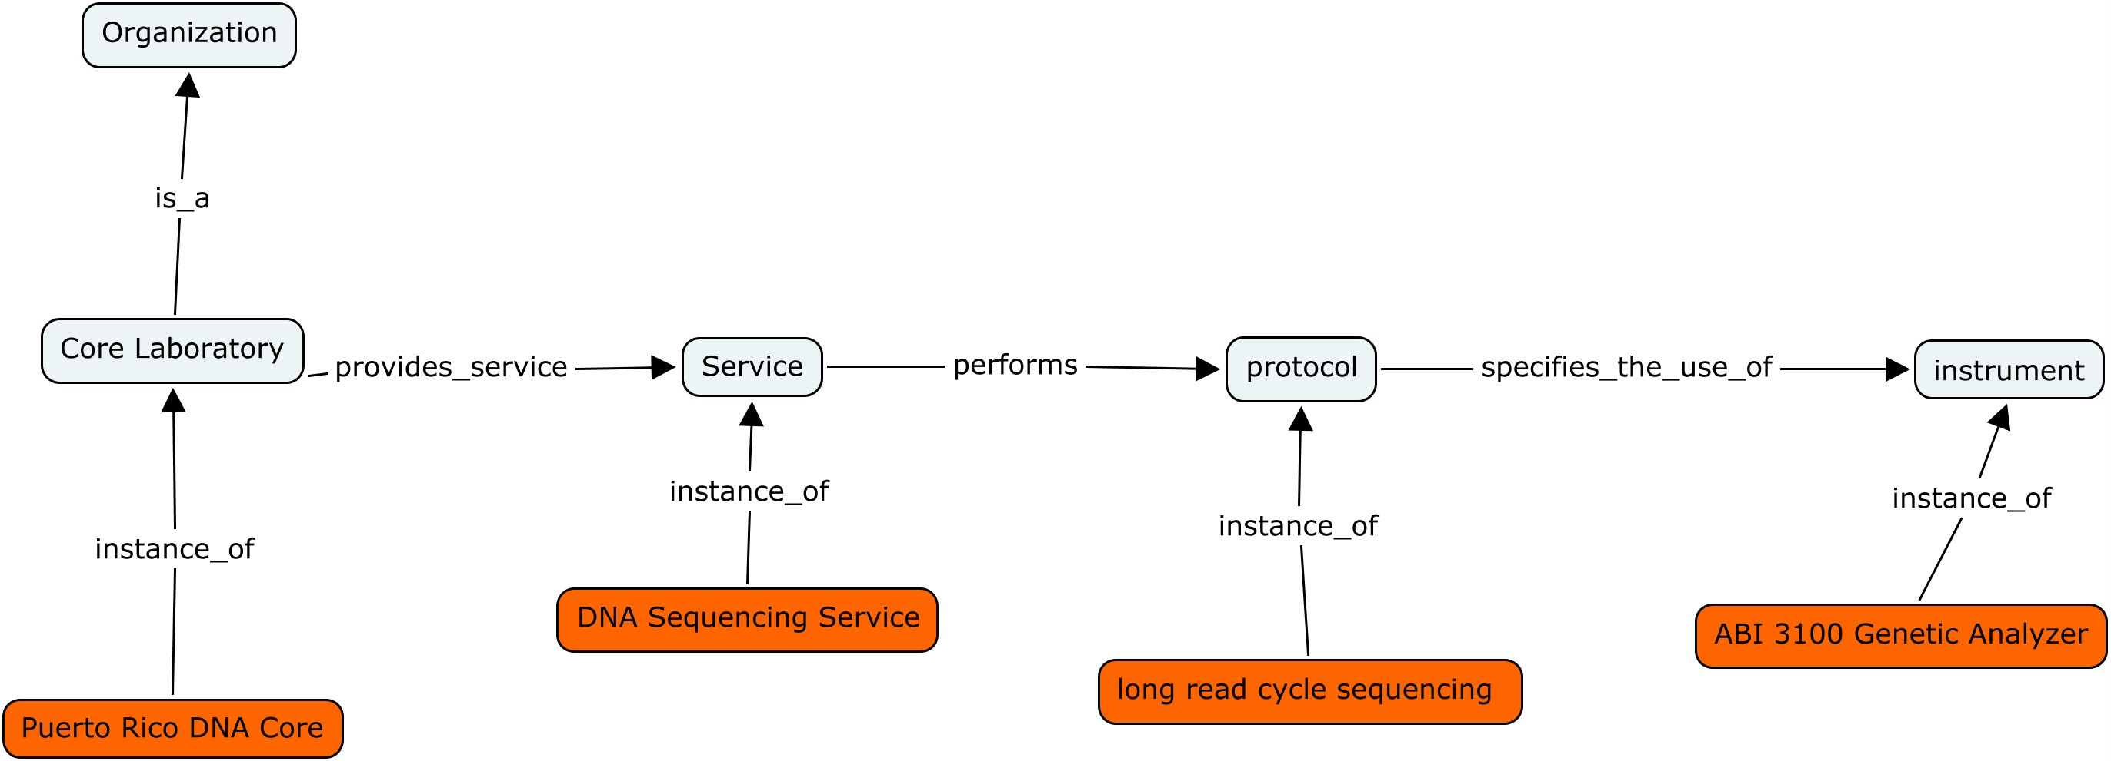
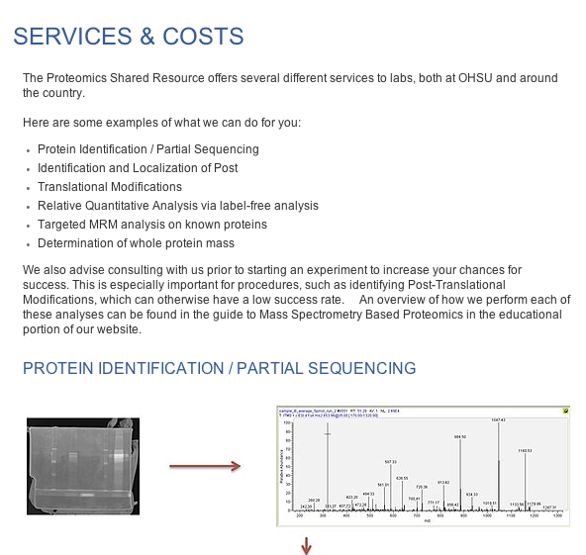
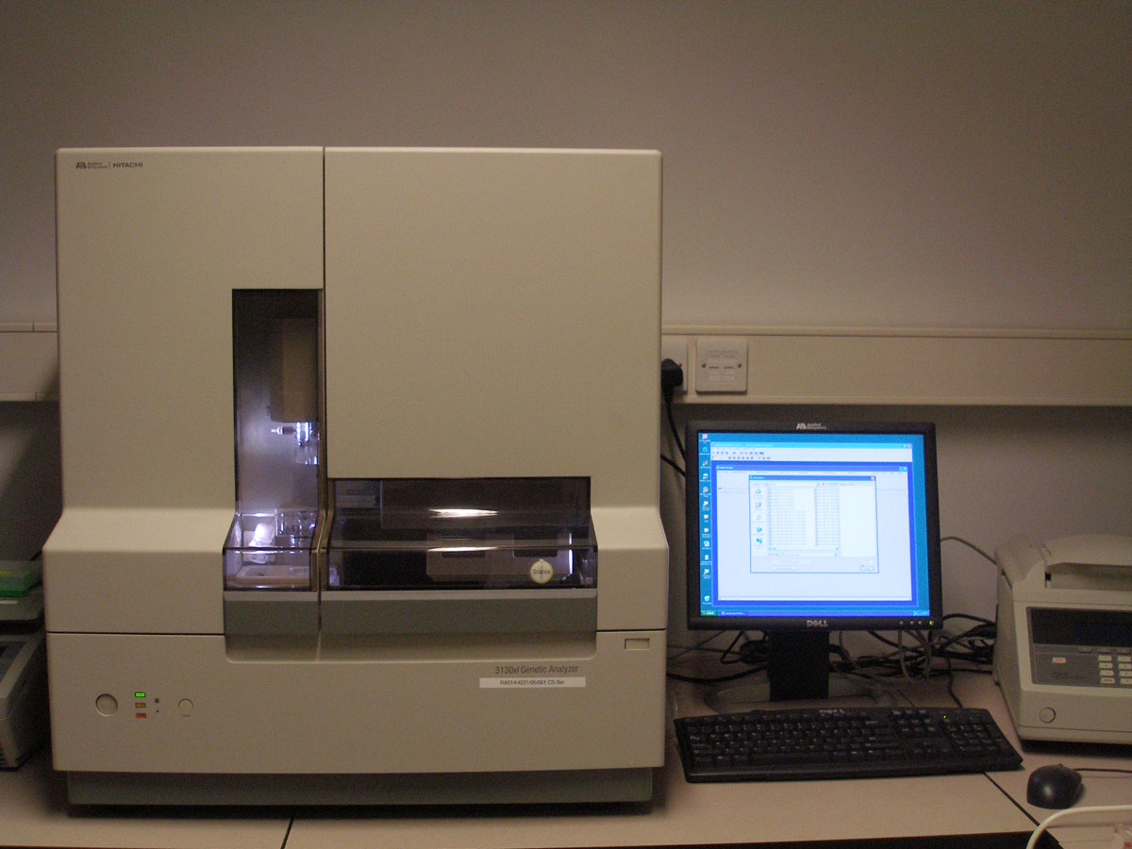
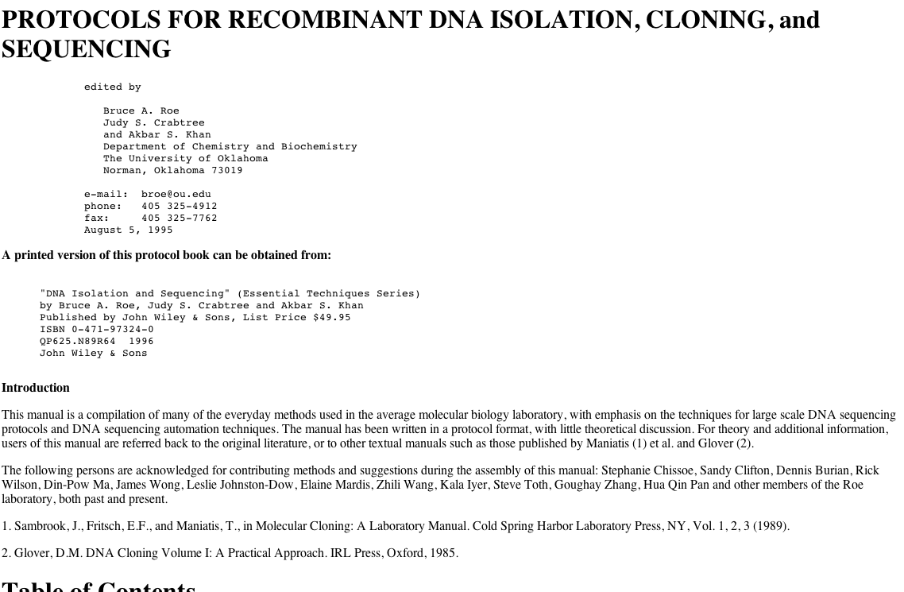
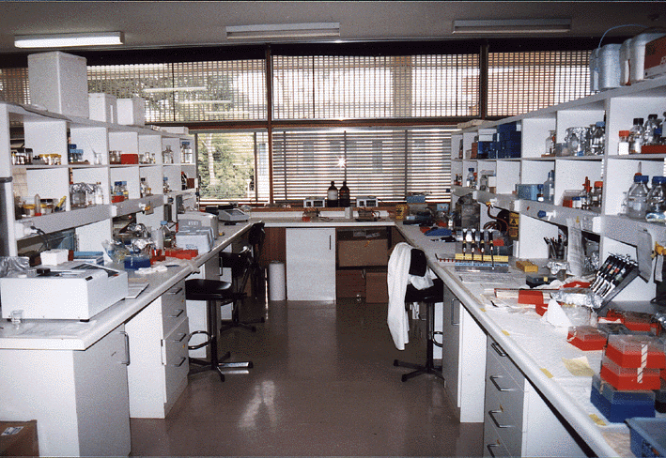
Scenario: lab provides a sequencing service
What types are we are collecting? What are the relationships between them?
Notes:
These are just first natural language derived between these types we are trying to evaluate and define logically

Slide 5
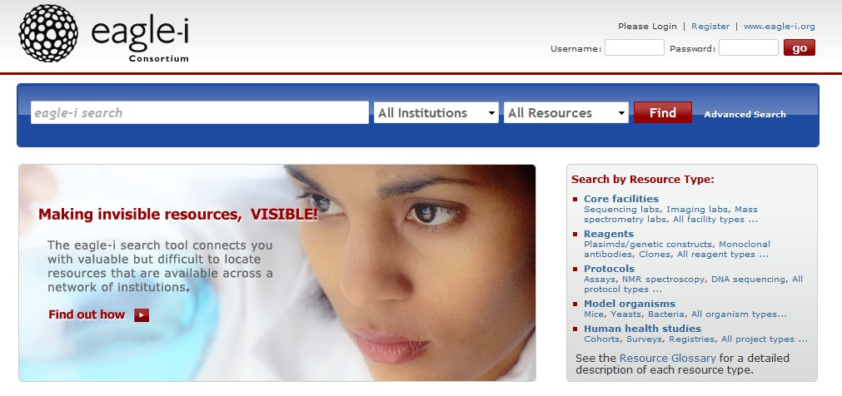
What questions do we want to be able to answer?
Which labs in my area provide DNA sequencing services?
Where is a DNA sequencer that can perform long read Cycle sequencing for me?
Who in my area knows how to perform long read Cycle sequencing?

Slide 6
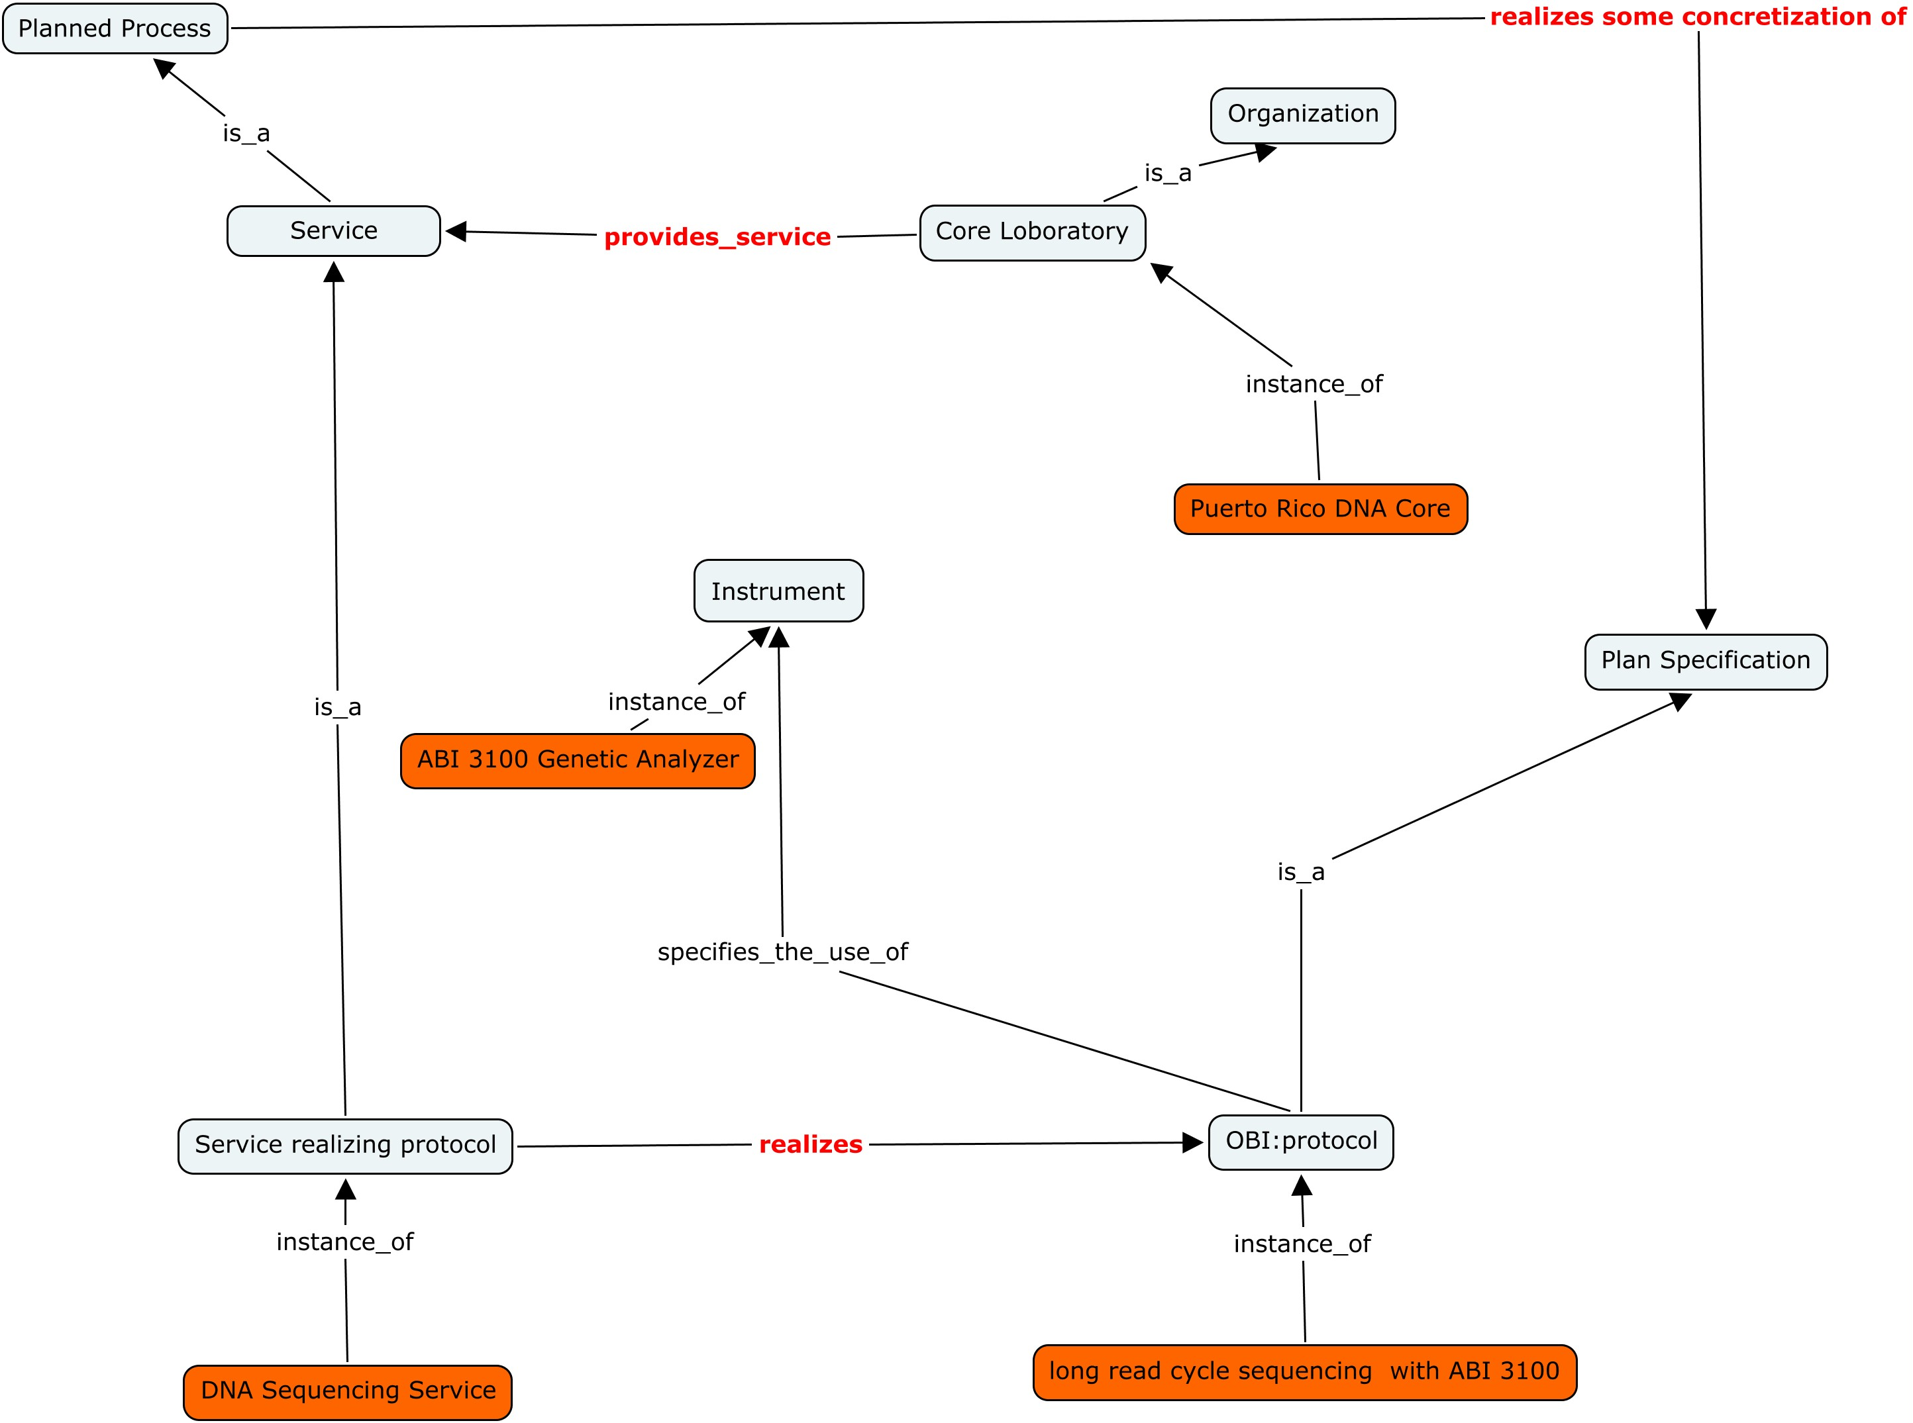
Protocol and service-realizing protocol

Slide 7
Scenario: Lab provides training and/or access
A resource navigator goes to lab in Puerto Rico:
This lab provides training on ABI 3100 Genetic Analyzer
The lab also provides user access to ABI 3100 Genetic Analyzer

Slide 8
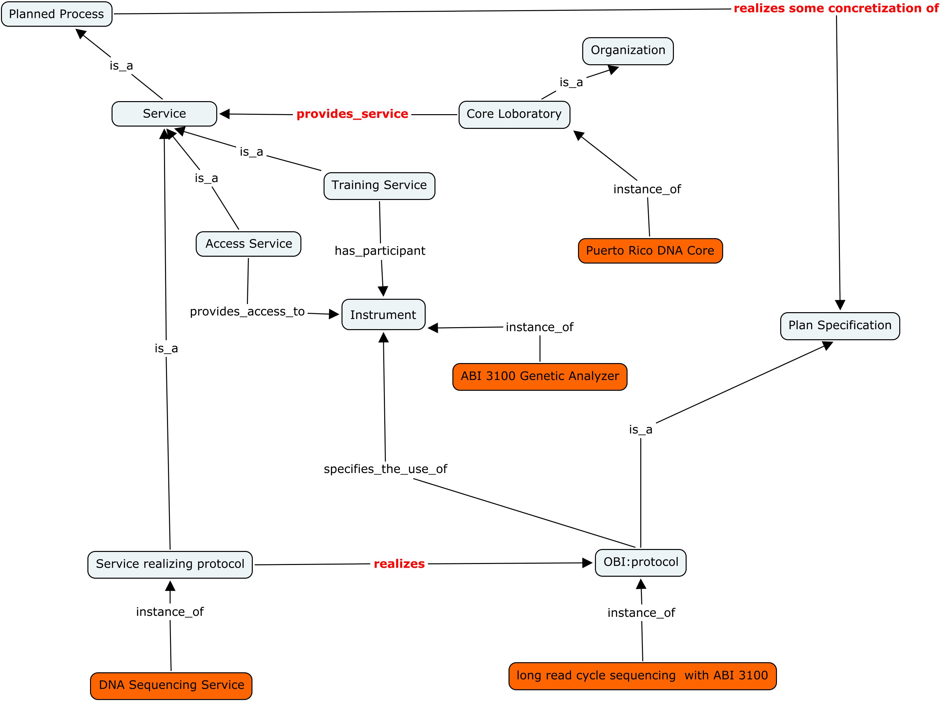
Lab provides training and/or access services

Slide 9
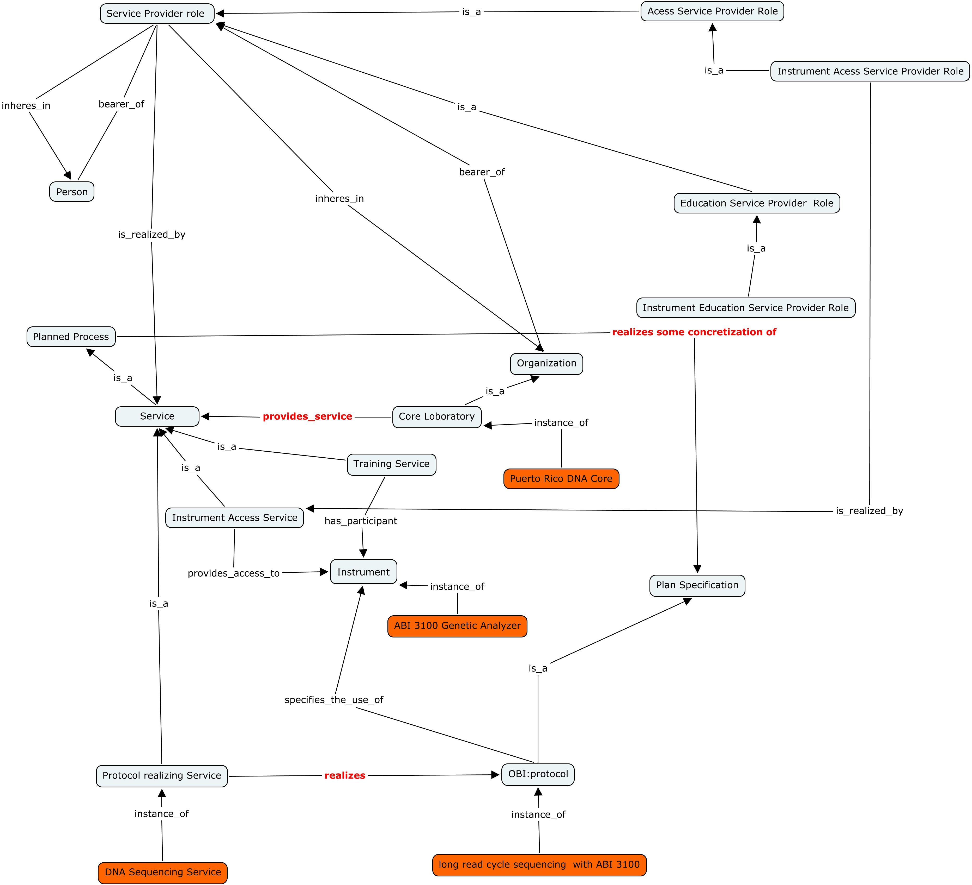
Exploring Service representation using roles

Slide 10
Can or should we define subclasses of service using roles?
Instrument access service = is_a Service and realizes (some) Instrument Access Service provider role?
Training Service = is_a Service and realizes (some) Education Service Provider role?

Slide 11
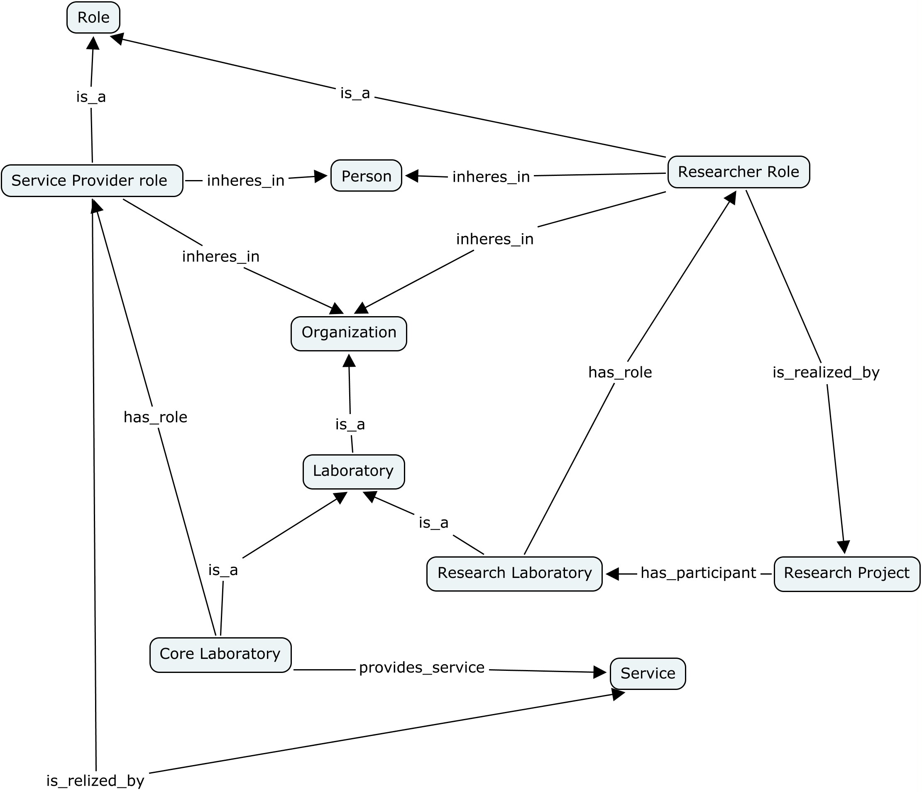
Defining subtypes of laboratory using roles

Slide 12
Can or should we define subtypes of laboratory using roles?
Core laboratory = is_a laboratory and has_role (some) Service Provider Role
Research laboratory = laboratory and has_role (some) research role
Laboratory class itself still needs a proper definition: issues with lab the organization of people and lab the location of research material entities

Slide 13
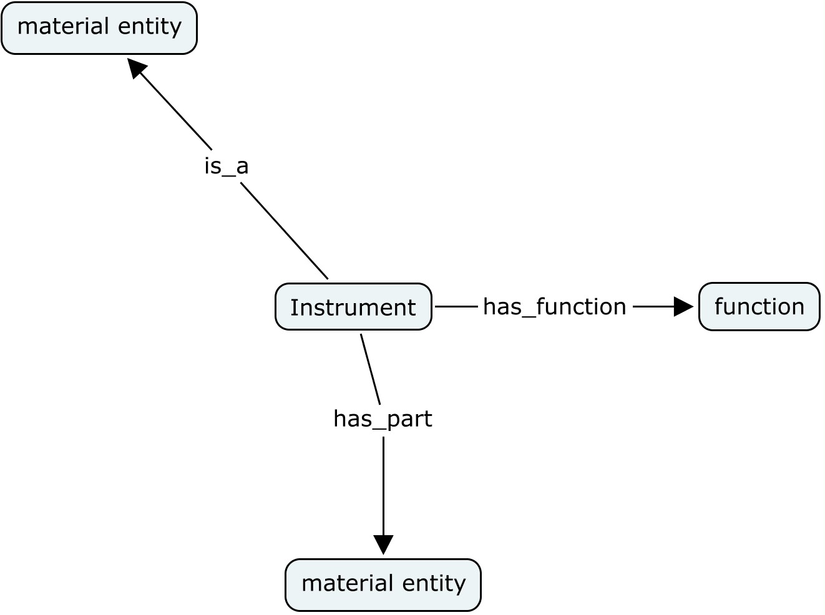
What are Instruments?

Slide 14
Summary of open questions
What is the proper way to use roles in order to
Define service classes
Define Organization classes
What are advantages/disadvantages in using roles?
possible increased complexity in answering queries
How shall we define instrument subclasses? using function?

Slide 15
Instruments Discussion
Possible classification of instruments based on function or participation in planned processes
electrophoresis instrument -> an instrument which has a “separation function” and participates in the planned process “electrophoresis”
environmental control system -> an instrument which has an ”environment control function”
Instrument parts classification
Status of terms request to OBI

